Slide 1





Meadowcroft Community Primary school
Welcome to Fox class
September 2025

Slide 2
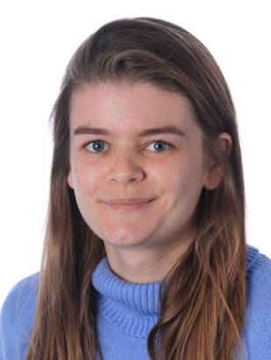
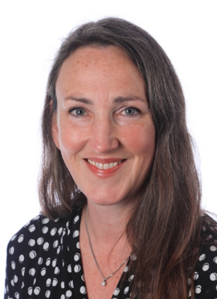
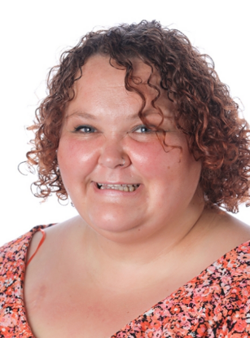
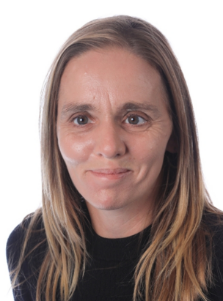
Meet the team:
Mrs Hat
Mrs Raven
Miss Latham
Miss Timbrell
Mrs Powlesland

Slide 3
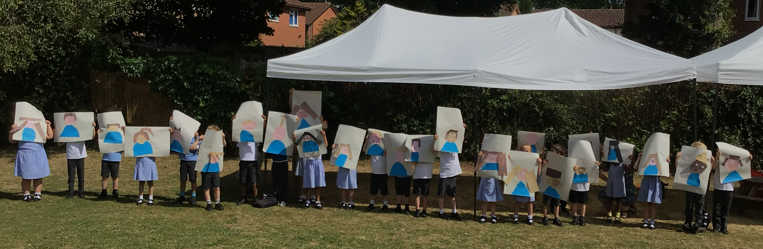
I had a wonderful morning with my new class in July and this new term has started positively. I am very much looking forward to a brilliant academic year.

Slide 4
A day in Fox Class
8.30am Doors open
8.50am Assembly
Morning session: Phonics, Guided Reading and English
10.45am Play time
Morning session: Maths
12pm Lunch time
Afternoon session: Foundation subjects
3pm Story
3.15pm Home time

Slide 5


What does my child need to bring every day?
Book bag – with reading book and reading record
Water bottle
Weather appropriate clothes (raincoat)
Please name everything.
Breakfast club and after school club are available.
These need to be booked in advance.

Slide 6

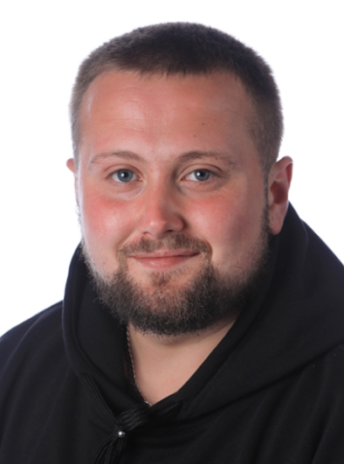
Physical Education
Children should come to school wearing their PE kit on Tuesdays and Thursdays. PE kits must be named and children should not wear earrings.
PE lessons on Tuesdays will be with Mr G and Miss Latham.
PE lessons on Thursday will be with Mrs Hat and Mrs Raven.

Slide 7
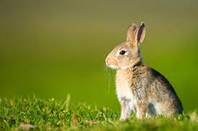
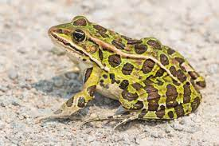
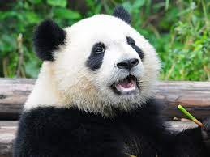

Respectful Rabbit
Meadowcroft Values
We have a behaviour ladder in all classes.
We use the Meadowcroft values to promote good behaviour in a positive way.
Please encourage these values at home.
Friendship Frog
Perseverance Panda
Truthful Tiger

Slide 8
Phonics screening will take place during the month of June. All children must be at school.
NO HOLIDAYS WILL BE AUTHORISED.

Slide 9




Slide 10

Reading
Please read to your child every day.
Please also listen to your child read every day.
Please write in your child’s reading record and include any books your child reads that are from your home or a library.
A school adult will read with your child each week (one-to-one and in small groups during guided reading) and write comments in our school reading records.

Slide 11
Achievement
There will be an achievement assembly each Friday where children are recognised for effort, progress and following the Meadowcroft Values.

Slide 12


If you are able to donate, we are always in need of photocopier paper and tissues.
Thank you!

Slide 13
Keep up to date with all that is happening in school:
Make sure you are signed up to Parentmail.
Read the weekly newsletters. The newsletters will tell you all the important information you need to know and key dates. There will also be a copy displayed on the classroom window.
The website is also updated regularly and at the end of every term there will be pictures on the website of the children’s learning.

Slide 14

Meadowcroft Friends
The Friends of Meadowcroft are always looking for more volunteers and ideas for fundraising.

Slide 15
Any questions?
Thank you!

