Slide 1
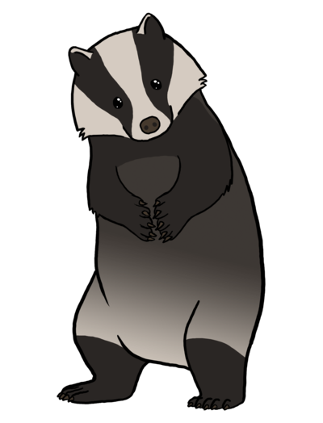
Meadowcroft Primary school
Welcome to Badger class

Slide 2
Welcome Parents!
Meet the team:
Mrs Mills - Class Teacher
Miss Latham, Miss Bridges, Mrs Raven, Mrs Rhodes, Miss Timbrell and Mrs Scott – Teaching Assistants

Slide 3

A day in Badger Class
Doors open - 8.30am
Registration - 8.45am
Assembly – 8:50am
Morning session with a break for 15 minutes
  Phonics, English, Handwriting and Maths
Lunch-11.45pm
  Followed by playtime
Afternoon session-12.45pm
  Guided Reading and Foundation subjects
Home time - 3.15 pm
Breakfast club and after school club are available – these need to be booked in advance.

Slide 4

Intervention Groups
Over and above the work done in class it may be felt that your child will benefit from extra support with their learning.
Intervention groups will vary in size and will concentrate on different aspects of work.
The most likely are handwriting, maths, reading or writing.
These groups are popular with the children as they feel special and are able to take part in practical activities.
If we are concerned about your child’s progress, we will speak to you and of course you can approach us if you have any concerns.

Slide 5

Reading
Please encourage reading as often as possible. Children are encouraged to read every evening. They do not need to read the entire book but reading regularly will enable their fluency and comprehension to develop further. In Badger class the children take ownership of their reading books and choose their own book from our school library.
We will be launching a new way to record your home reading – watch this space!

Slide 6

Physical Education
Lessons will be on Wednesday and Friday for Badger Class.
No jewellery. Earrings and ear piercing restrict P.E lessons and will affect your child’s playtime activities too.
Children need to arrive to school wearing their PE clothes on Wednesday and Friday.

Slide 7

Homework
In badger class we begin setting homework. These are tasks based on our learning in class.
Next week, each child will receive a red homework book which they can cover themselves and decorate in anyway they like. Please make sure that their name is visible and clear on the front of the book.
Homework will be set half termly and will be shared in class for everyone to enjoy. This is an opportunity to celebrate the work that the children produce. The ‘best’ pieces may even be sent to Mrs Underwood for extra recognition of their hard work.

Slide 8

Spelling
Children will also be sent home with a spelling list each Monday. The spellings will be linked to the words and sounds taught in our phonic lessons and will include tricky words. Please support your child in practising these spelling words at home. Accuracy when spelling becomes more important this year and weekly words are taken from the National Curriculum.
We will have a spelling quiz on these words each Friday morning.

Slide 9
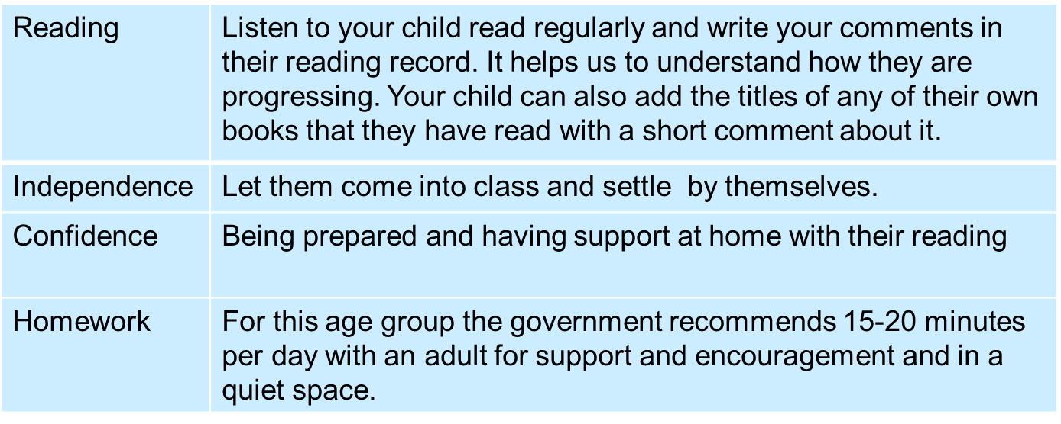
Helping your child: A summary
Named water bottle, named coat and named jumper/cardigan

Slide 10
Thank you!

