Slide 1
Meadowcroft Primary School
From September 2024
Notes:
Are your classroom colors different than what you see in this template? That’s OK! Click on Design -> Variants (the down arrow) -> Pick the color scheme that works for you!
Feel free to change any “You will…” and “I will…” statements to ensure they align with your classroom procedures and rules!

Slide 2
Welcome from Mrs Underwood
A little bit more about my background…
Teaching for over 30 years Experience in Key Stage 2 & some secondary teaching Established Head Teacher Ofsted Inspector Excellent support from the team!

Slide 3
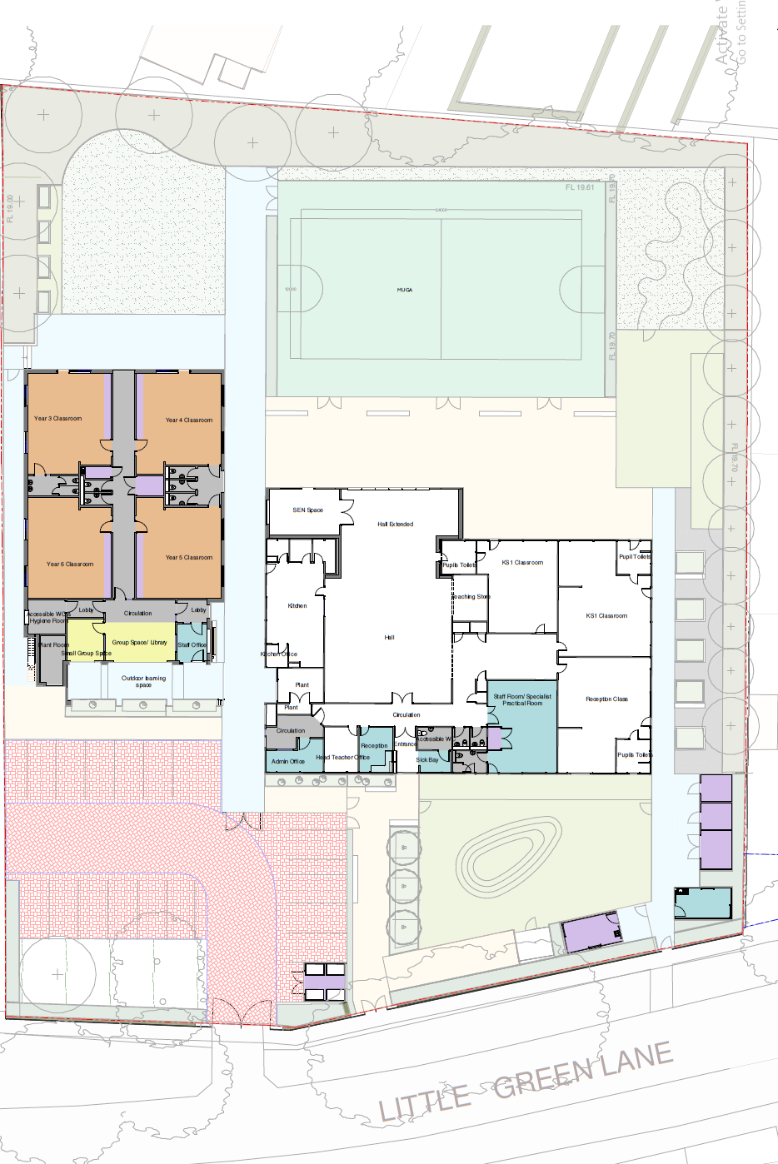
Where Are We Up To?
The Department for Education have approved Surrey’s proposal to make Meadowcroft an all through primary school from September 2024 The School’s Adjudicator has approved Surrey’s admissions variation to remove the link between Meadowcroft & St Ann’s Heath The planning application for the proposed building has been submitted to Surrey

Slide 4
What Does That All Mean?
The Department for Education have approved Surrey’s proposal to make Meadowcroft an all through primary school from September 2024 We will definitely have a Year 3 class from September 2024 The School’s Adjudicator has approved Surrey’s admissions variation to remove the link between Meadowcroft & St Ann’s Heath Children from Meadowcroft are no longer guaranteed a place at St Ann’s Heath The planning application for the proposed building has been submitted to Surrey Once Surrey County Council Planning Department has approved the application, building work will commence!

Slide 5
What Are My Options for Year 3?
At the End of Year 2 - July 2024
Your child has a Year 3 place at Meadowcroft If you want your child to go to a different school, you can apply as you would normally have done from October 2023 If you are offered a place at an alternative school you can accept the place and decide in July whether to send your child to that school or remain at Meadowcroft
Things You Need to Know
Primary School Applications Open – 30 October 2023 Deadline for Primary Applications – 12 January 2024 You only need to apply if you want your child to attend a different school St Ann’s Heath will not have capacity to accept all 30 Year 2 children from Meadowcroft

Slide 6

The Building Work
April 2024 – December 2024
We anticipate work will begin in April 2024 and will start with the demolition of part of the Caretaker’s Bungalow Contractors will extend the Hall and make refurbishments to the existing building Demolition of the remaining parts of the bungalow Build new Key Stage 2 block Works to front of site

Slide 7
Logistics!
Before… | During…
There will be lots to prepare Lots of sorting and packing things up Begin robust recruitment exercise for an experienced KS2 Teacher | Children’s safety is our number 1 priority Flexibility Patience Close liaison between school and project manager Keep disruption to a minimum by planning ahead
After…
Year 3 will occupy the first class in the new Key Stage 2 block Surrey are committed to providing adequate classroom space throughout the build We will all be able to enjoy the new space ☺

Slide 8

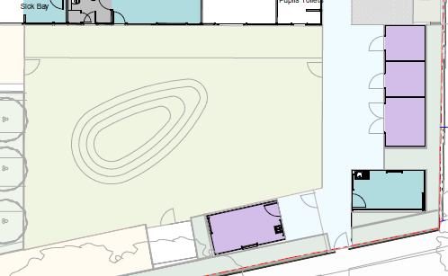
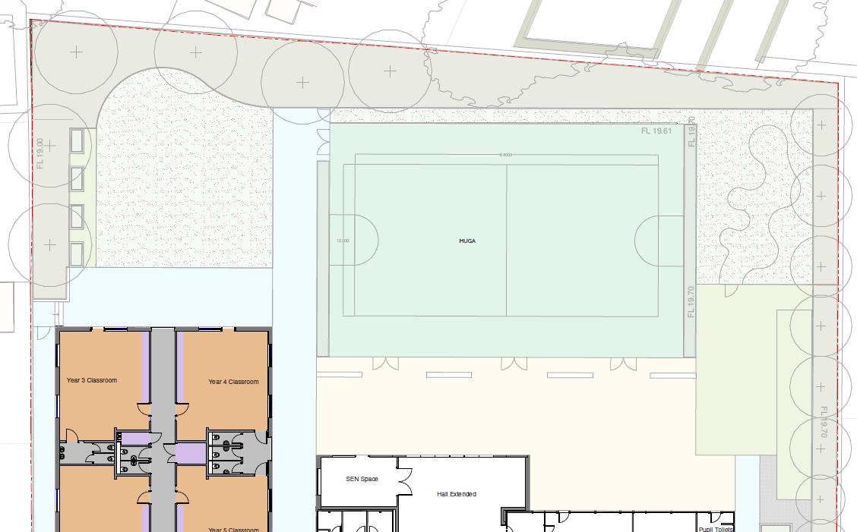
Playtimes / Lunchtimes
Staggered
Playtimes will be staggered Lunchtime in the hall will be staggered Reception and Year 1 will use the play area at the front of the school Older year groups will use the back playground at staggered times

Slide 9

PE
Curriculum – amount of PE KS1 / KS2 Use our new Multi Use Games Area (MUGA) Increase Sports Coach hours Negotiating with Salesian Short term borrow a mini bus from another school Long term buy our own mini bus (lots of fundraising & help from parents!!)

Slide 10
Traffic!
We’re all in this together
Encourage walking / cycling to school Staggered start and finish times Park & Stride Early Birds available to children with a sibling at St Ann’s Heath Junior School from 8.15am Traffic management resulting from surveys

Slide 11
QUESTIONS
Do you have any other questions…?

